Slide 1
Surety 101
Presented by:
Matt Rosenberg
Principal
Rosenberg & Parker

Slide 2
Surety is NOT Insurance
OBLIGEE
Three Parties
Obligee
Principal
Surety
No Losses
Indemnity
Rate
PRINCIPAL
SURETY

Slide 3
SAT Question 1
A bond can be cancelled mid-term?
True
False
It Depends

Slide 4
Surety is:
Credit
Prequalification
Ongoing and Continuous
Non-Cancelable (in most cases)
A Guarantee
Leverage

Slide 5
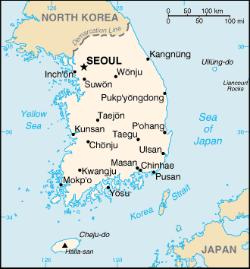
SAT Question 2
After the U.S. what country has the most annual premium?
South Korea
Canada
Mexico
Texas

Slide 6
SURETY SOUTH OF THE BORDER
REAL LIFE #1 Discuss Change

Slide 7
SAT Question 3
What was the total global surety industry premium in 2013?
$254.8 Billion
$13.0 Billion
$1.2 Trillion
$8.3 Million
215

Slide 8
SAT Question 4
What was the total global insurance premium in 2013?
$1.3 Trillion
$8.8 Trillion
$4.9 Trillion
$856.4 Billion

Slide 9
NUDGE NUDGE, WINK WINK
REAL LIFE #2

Slide 10
Surety Net Combined Ratio
Source: The Surety& Fidelity Association of America

Slide 11
U.S. Surety Marketplace 2000 vs. 2014
Top 15 Sureties – 2000
Top 15 Sureties – 2014
Travelers
St. Paul
CNA
Zurich
AIG
Liberty Mutual
ACE
Safeco
Chubb
Fireman’s Fund
Amwest
Kemper
Hartford
Seneca
Frontier
Travelers
Liberty Mutual
Zurich
CNA
Chubb
Hartford
IFIC
HCC
ACE
Great American
RLI
Lexon
NAS SwissRe
Arch Insurance
Merchants
Source: The Surety& Fidelity Association of America
Notes:
YOUR PRESENATION MUST INCLUDE THIS SLIDE!!

Slide 12
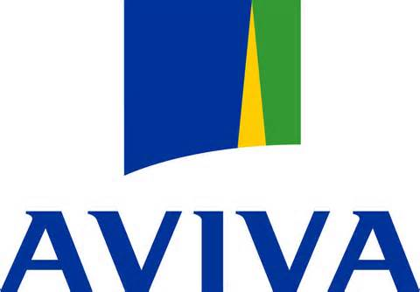
North America Sureties

Slide 13
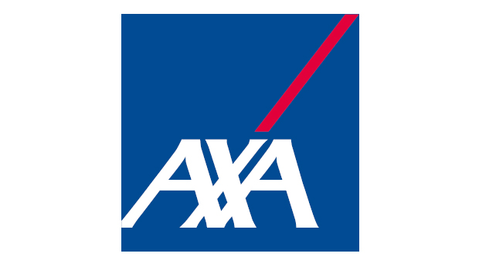
International Sureties

Slide 14
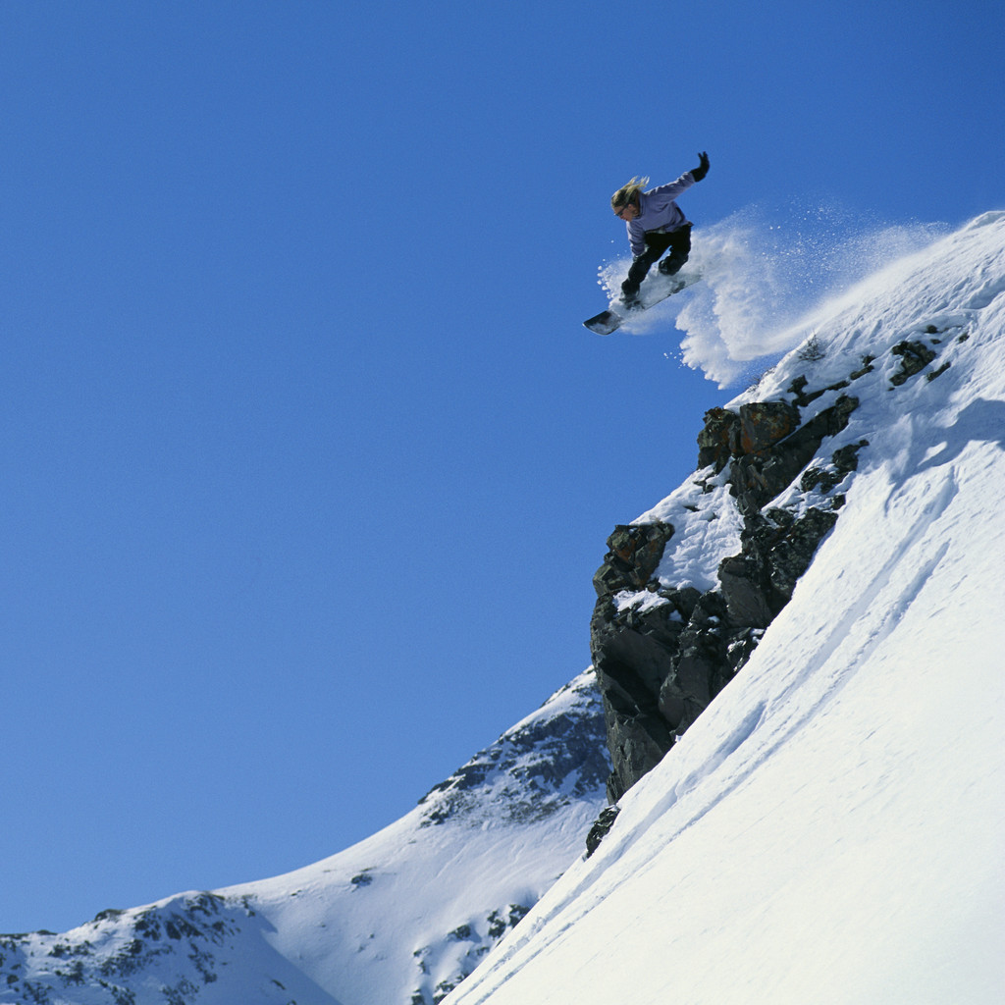
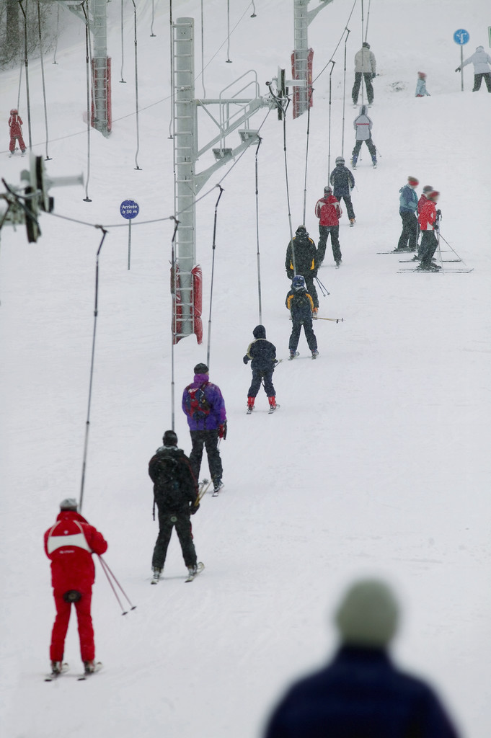
Bond Obligations
Performance and Payment
Supply
License and Permit
Customs
Injunction/Plaintiffs Appeal
Tax Appeal
Workers Compensation
Advanced Payment
Deductible
Defendants Appeal
Pure Financial Guarantee
Notes:
YOU MUST FOLLOW FORMAT FOR CONSISTENCY!!

Slide 15
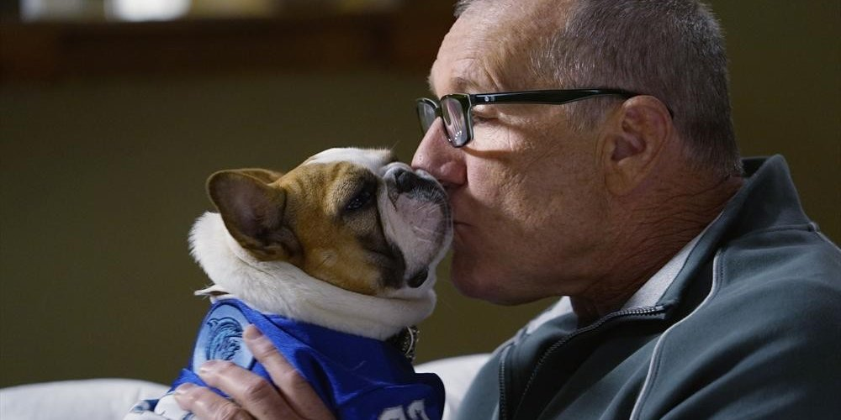
SAT Question 5
What is the name of Jay’s dog?
Fizbo
Lily
Stella
Bo Bo

Slide 16
Program Requirements
Types of Bonds
Duration
Cancelable/Continuous
Financial Guarantees
Forfeiture
Tail Exposures
Size and Capacity Requirements
Notes:
YOU MUST FOLLOW FORMAT FOR CONSISTENCY!!

Slide 17
Sr. Unsecured Debt Ratings

Slide 18
REAL LIFE #3
GETTING CREATIVE WITH SURETY

Slide 19
Financial Underwriting
Sr. Unsecured Debt Ratings
Transparency
Financial
Operational
Financial & Credit Profile
Profitability
Cash Flow
Liquidity
Capital Base
Security Packaging
Collateral
Indemnity
Notes:
YOU MUST FOLLOW FORMAT FOR CONSISTENCY!!

Slide 20
REAL LIFE #4
“you’re on your own kid.”

Slide 21
Bond Underwriting Criteria
Obligation
Bond Form Language
Duration
Bond Penalty
Pricing
Notes:
YOU MUST FOLLOW FORMAT FOR CONSISTENCY!!

Slide 22
Program Considerations
Professional surety broker
Continuous and open communication
Multiple sureties
Limited capacity
Built in back-up
Overflow capacity
Competition
Different sureties for different obligations
Notes:
YOU MUST FOLLOW FORMAT FOR CONSISTENCY!!

Slide 23
REAL LIFE #5
“I love ‘em!”
“I hate ‘em!”

Slide 24
Surety Markets
Global Premiums USD 13 billion 2013
US Largest Market 40% of Global Premiums
US Growth Slowed Down
South Korea Asia’s Largest Surety Market - USD 1.4 Billion Premiums 2013
Mexico Largest Surety Market in Latin America
Columbia and Brazil Substantial in Latin America
Latin America 10% Increase 2000 through 2013
Source: Swiss Re Trade credit insurance & surety: taking stock after the financial crisis – October 2014
Notes:
YOUR PRESENATION MUST INCLUDE THIS SLIDE!!

Slide 25
Cycle Management
Low Periods Stable Activity Followed by Short Spikes
Note: Light blue bars denote years in which recession began
Source: The Surety and Fidelity Association of America, National Bureau of Economic Research, Swiss Re Economic Research & Consulting

Slide 26
Surety vs. Bank
Source: International Credit Insurance & Surety Association (ICISA).

Slide 27
Conditional Surety Bonds vs. On Demand Guarantee Bonds
Conditional Surety Bonds
Beneficiary Must Provide Evidence
Surety Company will Investigate the Claim for Validity
Only Once Claim is Verified as True Surety Company Reimburses Beneficiary
Sureties and Principals Prefer ODG Bonds
On Demand Guarantee Bonds
Surety Company Must Pay Out Whenever Beneficiary Demands Payment
Demand Can be Even if There is No Breach of Contract
Surety Company Can Claim Money Back if Bond was Called Unfairly
Most Beneficiaries Prefer Unconditional Surety Bonds
Notes:
YOU MUST FOLLOW FORMAT FOR CONSISTENCY!!

Slide 28
Learning Objectives
Surety Mirrors Banking
Global Surety Market Has Increased Dramatically
No Two Surety Programs Are Alike
Notes:
YOUR PRESENATION MUST INCLUDE THIS SLIDE!!

Slide 29
Questions?
suretybond.com

